Slide 1
CPSC 481 Artificial Intelligence
Mr. Ayush Bhardwaj
abhardwaj@fullerton.edu

Slide 2
What we will cover today
Optimization problems and Local search algorithms
Hill climbing search
Simulated annealing
Genetic algorithms

Slide 3
Path vs. Goal
BFS/DFS/UCS/A* all return a path to a goal state
The goal state is known (consider sliding tile puzzle)
Difficult part is getting there from the initial state
Good:
Optimal
Systematic search of the entire state space
Bad:
Slow
high/infeasible memory requirement
Applications
Solving puzzles
Robot path planning
Parsing natural language (text -> grammar)
Wireless network routing

Slide 4
Path vs. Goal

Slide 5
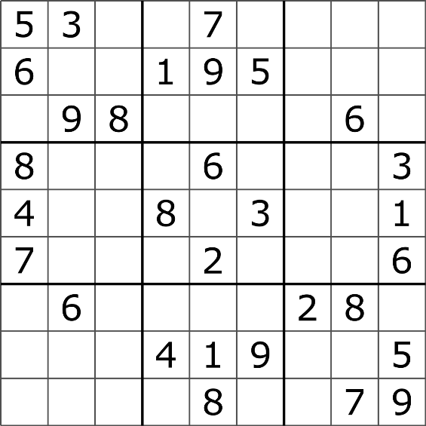
Path vs. Goal
Optimization problems
Find any goal state
Path used to find the goal state is not important
Applications
Course scheduling: fit as many classes in classrooms
Job scheduling
Constraint satisfaction problems: Sudoku
Good:
Don’t worry about keeping track of paths
Fast
Bad:
Lose optimality

Slide 6
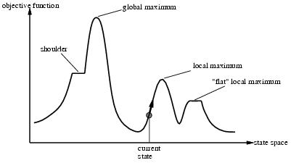
Optimization problems
Find the “best” state according to an objective function
Objective function: state → number
Find largest value of objective function: maximization
Find smallest value of objective function: minimization
“State space landscape” for search for maximum

Slide 7
Local search
Challenge:
Very large number of states
Key idea:
Keep track of a “current state”
And its objective function value
Consider only successors of current state
Successor of a state: a state that is only “slightly different” from that state (also called neighbor)
If a successor is better than current state (higher objective function value), replace current state with this successor
Ignore paths
Repeat

Slide 8

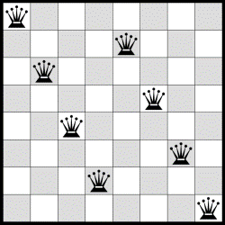
Example optimization problem
8-queens problem
Place 8 queens on a chessboard such
that no queen attacks another
Size of state space?
How to represent the state?
((1,8),(2,6),(3,4),(4,2), …)
(8, 6, 4, 2, 7, 5, 3, 1) simpler
Successors?
All states where only one queen is moved
Objective function
Minimization: Number of pairs of queens that are attacking each other
For shown state?
Global minimum: 0
Is this a local minimum?
Maximization: Number of pairs of queens that do not attack each other
Is this a global maximum?
8
7
6
5
4
3
2
1
1 2 3 4 5 6 7 8

Slide 9
Global and local maximum
Global maximum:
A state that has the highest possible objective function value in the entire state space
Local maximum
A state that has the highest possible objective function value among all its successors
Similarly for global and local minimum

Slide 10
Classwork
Represent this board as an 8-tuple
Calculate the objective function
number of attacking pairs
Generate a few successor states
List the 8-tuples
Calculate the objective function for a few successor states
8
7
6
5
4
3
2
1
1 2 3 4 5 6 7 8

Slide 11
Hill climbing
Local search

Slide 12
Hill-climbing search
function HILL-CLIMBING( problem) return a state that is a local maximum
input: problem, a problem
local variables: current, a node.
neighbor, a node.
current ← MAKE-NODE(INITIAL-STATE[problem])
loop do
neighbor ← a highest valued successor of current
if VALUE [neighbor] ≤ VALUE[current] then return STATE[current]
current ← neighbor
Algorithm sketch
Expand the current state of the search.
Evaluate its successor states using the objective function.
Select the best successor state for further expansion.
Continue steps 1 - 3 until no better state is found

Slide 13
Hill-climbing search
Advantages:
Uses very little memory
Can often find reasonable solutions in large or infinite (continuous) state spaces.
But not optimal
Gets stuck in local maxima
Greedy local search

Slide 14
Problems of Hill-climbing
Local maxima
gets stuck when it reaches a state that has no neighboring states that are better.
Shoulder
all direct successors are not better; but a close neighbor is
Plateau
All neighboring states are not better; how far away should I keep looking for a better state?

Slide 15
Variations of Hill-climbing
Steepest ascent
Version seen previously
Stochastic hill-climbing
Of all better successors, choose one randomly
Intentionally not always choosing the best
Slower but finds better solutions in some cases
First-choice hill-climbing
Randomly choose first better successor
Suitable when there are thousands of successor states
Random-restart hill climbing
If you get stuck, start over from a random state (but note the best state seen so far)
Beam search
Maintain a pool of k current states – the “beam”
Generate all successors of the k current states; keep only the best k successors for the new beam

Slide 16
Simulated annealing
Local search

Slide 17
Simulated Annealing (SA)
A hill-climbing algorithm that never goes downhill will get stuck in local maxima
Better to do a random walk!
Will eventually find the global maximum
Can we combine the two?
Make some downhill moves
But not completely randomly

Slide 18
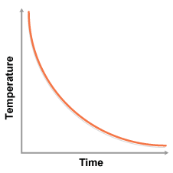
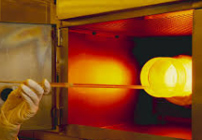
Annealing
In metallurgy, a technique of heating and slowly cooling metals/glass to reduce their defects and make them easier to machine
Notes:
*These are mathematical optimization problems--annealing schedule, p = e^{-ΔE/T}
*Each step of the SA algorithm replaces the current solution by a random "nearby" solution, chosen with a probability that depends both on the difference between the corresponding function values and also on a global parameter T (called the temperature), that is gradually decreased during the process. The dependency is such that the current solution changes almost randomly when T is large, but increasingly "downhill" as T goes to zero. The allowance for "uphill" moves saves the method from becoming stuck at local optima—which are the bane of greedier methods.
+Guarantee? NO (since nondeterministic)

Slide 19
Physical Interpretation of Simulated Annealing
simulated annealing:
free variables are like molecules
seek “low energy” (high quality) configuration
Note: minimization but equally applies to maximization
get this by slowly reducing temperature T, which controls how randomly particles move
Notes:
Random walk, break chemical bonds and release force

Slide 20
Simulated Annealing
function SIMULATED-ANNEALING( problem, schedule) return a solution state
input: problem, a problem
schedule, a mapping from time to temperature
local variables: current, a node.
next, a node.
T, a “temperature” controlling the probability of downward steps
current ← MAKE-NODE(INITIAL-STATE[problem])
for t ← 1 to ∞ do
T ← schedule[t] # T -= 0.01
if T = 0 then return current
next ← a randomly selected successor of current
∆E ← VALUE[next] - VALUE[current]
if ∆E > 0 then current ← next
else current ← next only with probability e^{∆E /T}
Algorithm sketch: At each iteration, SA considers some neighbor, next of the current state current, and probabilistically decides whether to move from next to current.
Repeat for a large number of iterations.
Notes:
If next is better, choose next
If next is not better, choose next with p
T decreases, so probability increases

Slide 21
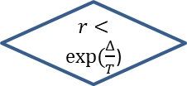
Search using Simulated Annealing
Simulated Annealing = hill-climbing with stochastic moves
Basic ideas:
like hill-climbing but instead of picking the best move, pick one randomly
Δ = change in objective function value
if Δ is positive, then move to that state
Otherwise:
move to this state with probability proportional to Δ
thus: worse moves (large negative Δ) are executed less often
There is always a chance of escaping from local maxima over time
next = randomly selected neighbor of current
Δ = E(next) – E(current)
NO
Δ > 0
YES
$r<exp⁡(\frac{Δ}{T}$)
current = next
NO
YES
current = current (no change)
current = next
decrease T

Slide 23
Simulated Annealing example
Current state value = 20
Current temperature T = 1
3 moves/successors:
Objective function value = 19.1, ΔE₁ = -0.9
Value = 20.5, ΔE₂ = +0.5
Value = 15, ΔE₃ = -5
pick a move randomly:
if E₂ is picked, move there (since ΔE₂ > 0)
if E₁ or E₃ is picked, move there with probability = exp(ΔE/T)
move 1: prob. = exp(-0.9) = 0.406,
i.e., 40% of the time we will accept this move
move 3: prob. = exp(-5) = 0.006
i.e., 0.6% of the time we will accept this move
Notes:
d: delta E

Slide 24
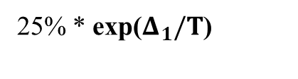
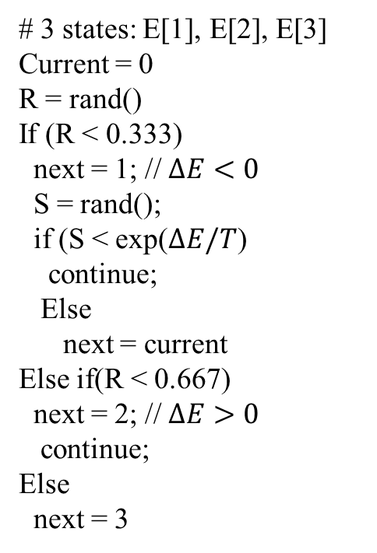
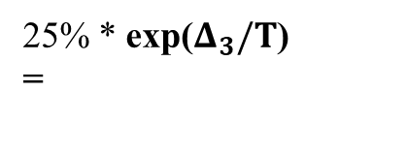
5
25%
6
2
25%
# 3 states: E[1], E[2], E[3]
Current = 0
R = rand()
If (R < 0.333)
next = 1; // $ΔE<0$
S = rand();
if (S < exp($ΔE/T$)
continue;
Else
next = current
Else if(R < 0.667)
next = 2; // $ΔE>0$
continue;
Else
next = 3
0
1
25% * exp($Δ_{1}/T$)
3
25% * exp($Δ_{3}/T$)
=
4

Slide 25
Class work
Let current state value be 25
Has 4 neighbors with values: 23, 20, 28, 30
Calculate the probability of
Moving to 23
Moving to 20
Moving to 28
Moving to 30
Staying at 25
Repeat for T=1 and T=10

Slide 26
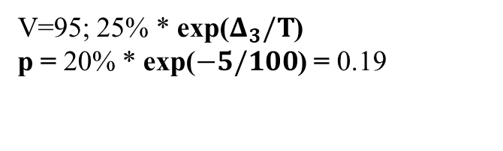
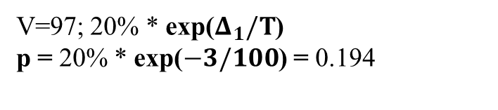
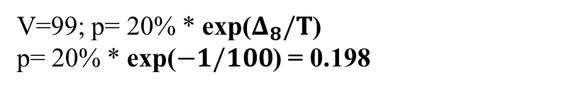
5
V=105; p=0.2
6
T=100
2
V=102; p=0.2
0
V=99; p= 20% * exp($Δ_{8}/T$)
p= 20% * exp($−1/100$) = 0.198
8
1
V=97; 20% * exp($Δ_{1}/T$)
p = 20% * exp($−3/100$) = 0.194
3
V=95; 25% * exp($Δ_{3}/T$)
p = 20% * exp($−5/100$) = 0.19
4

Slide 27
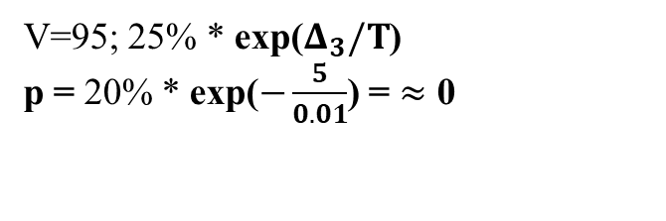
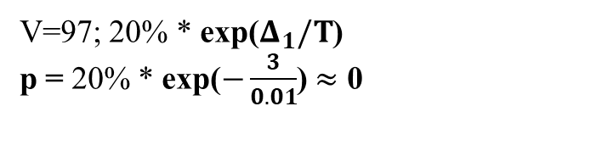
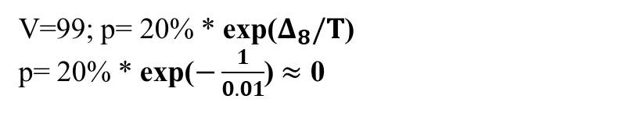
5
V=105; p=0.2
6
T=0.01
2
V=102; p=0.2
0
V=99; p= 20% * exp($Δ_{8}/T$)
p= 20% * exp($−\frac{1}{0.01}$) $≈$ 0
8
1
V=97; 20% * exp($Δ_{1}/T$)
p = 20% * exp($−\frac{3}{0.01}$) $≈$ 0
3
V=95; 25% * exp($Δ_{3}/T$)
p = 20% * exp($−\frac{5}{0.01}$) = $≈$ 0
4

Slide 28
Performance of Simulated Annealing
T = “temperature” parameter
high T => probability of “locally bad” move is higher
low T => probability of “locally bad” move is lower
T is decreased as the algorithm runs longer
Annealing schedule
If the schedule is slow enough, SA finds the global optimum (with probability approaching 1)
SA was proposed in 1983 by IBM researchers for solving VLSI layout problems (Kirkpatrick et al., Science, 220:671-680, 1983)
Also used for other problems: scheduling …
Useful for some problems, but can be very slow
slowness comes about because T must be decreased very gradually to retain optimality
In practice how do we decide the rate at which to decrease T?
a practical problem with this method

Slide 29
Genetic algorithms
Local search

Slide 30
Evolution by Natural Selection
Genome and heredity
Genome is a complete set of chromosomes for a specie. Half of the genome (DNA) is passed from parent to child. Thus, heredity is passed through the genome.
Genetic variation in a population is
the results of principal forces: mutation (various reasons) and crossover (sexual recombination) of genetic code (DNA)
Evolution is
the results of natural selection (or survival of the fittest) over multiple generations through Inheritance (from reproduction) and genetic variation (from crossover and mutation).
What do these DNA and Evolution have to do with our problem solving approaches?
Notes:
*Reproduction: DNA replication or mutation, asexual reproduction during cell division or crossover as a result of sexual recombination. DNA recombination.
Mutation reasons: environment, climate, pollution, disease

Slide 31
How to use Biological Knowledge in Problem Solving?
What we have learned from Biologists:
How the information about functions and traits for an individual is represented and where it is stored.
Evolutionary mechanism
How is a member in a population evaluated: Natural selection
How does a population evolve? Genetic variation
What causes genetic variations?
Inheritance
Sexual reproduction: crossover of genes from both parents
Mutation: random change
Importance of diversity in a population in evolution
History teaches us that all closed societies failed to survive.
How can we use this knowledge to solve problems?
Simulation of the evolutionary mechanism
Genetic algorithms
Introduced by Holland and colleagues in 1975

Slide 32
GA: terminology
Population
A set of candidate solutions/states
Crossover
Combining parts of two states to create a child state
Mutation
A random change in one bit of a state
Fitness function
A numeric measure of the relative goodness of a state

Slide 33
Genetic Algorithm
function GENETIC-ALGORITHM(population, fitness) returns an individual
repeat
weights ←WEIGHTED-BY(population, fitness)
population2 ← []
for i = 1 to SIZE(population) do
parent1 , parent2 ←WEIGHTED-RANDOM-CHOICES(population,weights, 2)
child ←REPRODUCE(parent1, parent2 ) // crossover
if (small random probability) then child ←MUTATE(child)
add child to population2
population ←population2
until some individual is fit enough, or enough time has elapsed
return the best individual in population, according to fitness
function REPRODUCE(parent1, parent2 ) returns an individual
n←LENGTH(parent1)
c←random number from 1 to n
return APPEND(SUBSTRING(parent1, 1, c), SUBSTRING(parent2, c + 1, n))

Slide 34
8-queens problem
2 4 7 4 8 5 5 2
3 2 7 5 2 4 1 1
f()=24 (31%)
3 2 7 5 2 4 1 1
2 4 7 4 8 5 5 2
f()=23 (29%)
2 4 4 1 5 1 2 4
3 2 7 5 2 4 1 1
f()=20 (26%)
3 2 5 4 3 2 1 3
2 4 4 1 5 1 2 4
f()=11 (14%)
(a) Initial population
(c) Selection
(b) Fitness function

Slide 35
8-queens problem
2 4 7 4 8 5 5 2
3 2 7 5 2 4 1 1
3 2 7
5 2 4 1 1
f()=24 (31%)
3 2 7 5 2 4 1 1
2 4 7
4 8 5 5 2
2 4 7 4 8 5 5 2
f()=23 (29%)
3 2 7 5 2 4 1 1
3 2 7 5 2
3 2 7 5 2 4 1 1
2 4 4 1 5 1 2 4
4 1 1
f()=20 (26%)
3 2 5 4 3 2 1 3
2 4 4 1 5 1 2 4
2 4 4 1 5
2 4 4 1 5 1 2 4
1 2 4
f()=11 (14%)
(a) Initial population
(c) Selection
(d) Crossover
(b) Fitness function

Slide 36
8-queens problem
2 4 7 4 8 5 5 2
3 2 7 5 2 4 1 1
3 2 7
4 8 5 5 2
3 2 7 4 8 1 5 2
f()=24 (31%)
3 2 7 5 2 4 1 1
2 4 7 4 8 5 5 2
2 4 7
5 2 4 1 1
2 4 7 5 2 4 1 1
f()=23 (29%)
2 4 4 1 5 1 2 4
3 2 7 5 2 4 1 1
3 2 7 5 2
1 2 4
3 2 2 5 2 1 2 4
f()=20 (26%)
3 2 5 4 3 2 1 3
2 4 4 1 5 1 2 4
2 4 4 1 5
4 1 1
2 4 4 1 5 4 1 7
f()=11 (14%)
(a) Initial population
(c) Selection
(d) Crossover
(e) Mutation
(b) Fitness function

Slide 37
8-queens problem: crossover
+
=
[3 2 7 5 2 4 1 1]
[2 4 7 4 8 5 5 2]
= [3 2 7 4 8 5 5 2]

Slide 38
Classwork: crossover
Show a few other “children” of these two parent states
[3 2 7 5 2 4 1 1]
[2 4 7 4 8 5 5 2]

Slide 39
Setting up a GA for a specific problem
Representation for a candidate solution (DNA)
Use a fixed length string (binary bit string).
Initial population of candidate solutions (chromosomes)
Create randomly (each candidate solution can be a random binary string.)
Fitness criteria (measure for survival of fitness)
Define a fitness function f(x) to evaluate each candidate solution.
Creating next population with genetic variations (evolution)
Select survived candidate solutions.
Apply genetic operators to the selected solutions to produce improved solutions in next generation (offsprings with modified DNA).
Terminating conditions and other parameters
population size, probability of crossover, probability of mutation, number of generations, etc.

Slide 40
Performance of GA
Have been used in many optimization problems
Scheduling
Traveling Salesman Problem
Works well for problems where parts of a good candidate should be left unchanged
Disadvantages
Representation is not obvious and impacts how well it does
Several hyper-parameters:
Size of population, mutation probability, number of iterations, terminating condition, …

Slide 41
References
George F. Luger, Artificial Intelligence: Structures and Strategies for Complex Problem Solving, 6th edition, Addison Wesley, 2009. Chapters 4.1.1, 12.1.
Russel and Norvig, Artificial Intelligence: A Modern Approach, 3rd edition, Prentice Hall, 2010. Chapter 4-4.1

